Slide 1
Azure Databricks
[Speaker Name]

Slide 2
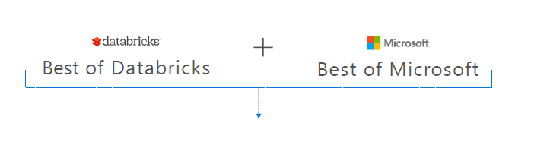
A fast, easy and collaborative Apache® Spark™ based analytics platform optimized for Azure

Slide 3
Azure Databricks
Designed in collaboration with the founders of Apache Spark
One-click set up; streamlined workflows
Interactive workspace that enables collaboration between data scientists, data engineers, and business analysts.
Native integration with Azure services (Power BI, SQL DW, Cosmos DB, Blob Storage)
Enterprise-grade Azure security (Active Directory integration, compliance, enterprise -grade SLAs)

Slide 4
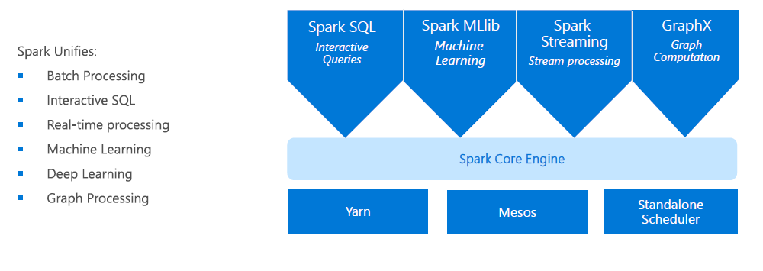
Apache Spark
An unified, open source, parallel, data processing framework for Big Data Analytics

Slide 5
Advantages of a unified platform
Improves developer productivity – a single consistent set of APIs
All different systems in the Spark share the same abstraction
Developers can mix and match different kind of processing in the same application. This is a common requirement for many big data pipelines
Performance improves because unnecessary movement of data across engines is eliminated

Slide 6
Differentiated experience on Azure
Enhance Productivity
Get started quickly by launching your new Spark environment with one click.
Share your insights in powerful ways through rich integration with Power BI.
Improve collaboration amongst your analytics team through a unified workspace.
Innovate faster with native integration with rest of Azure platform
Build on the most compliant cloud
Simplify security and identity control with built-in integration with Active Directory.
Regulate access with fine-grained user permissions to Azure Databricks’ notebooks, clusters, jobs and data.
Build with confidence on the trusted cloud backed by unmatched support, compliance and SLAs.
Scale without limits
Operate at massive scale without limits globally.
Accelerate data processing with the fastest Spark engine.

Slide 7
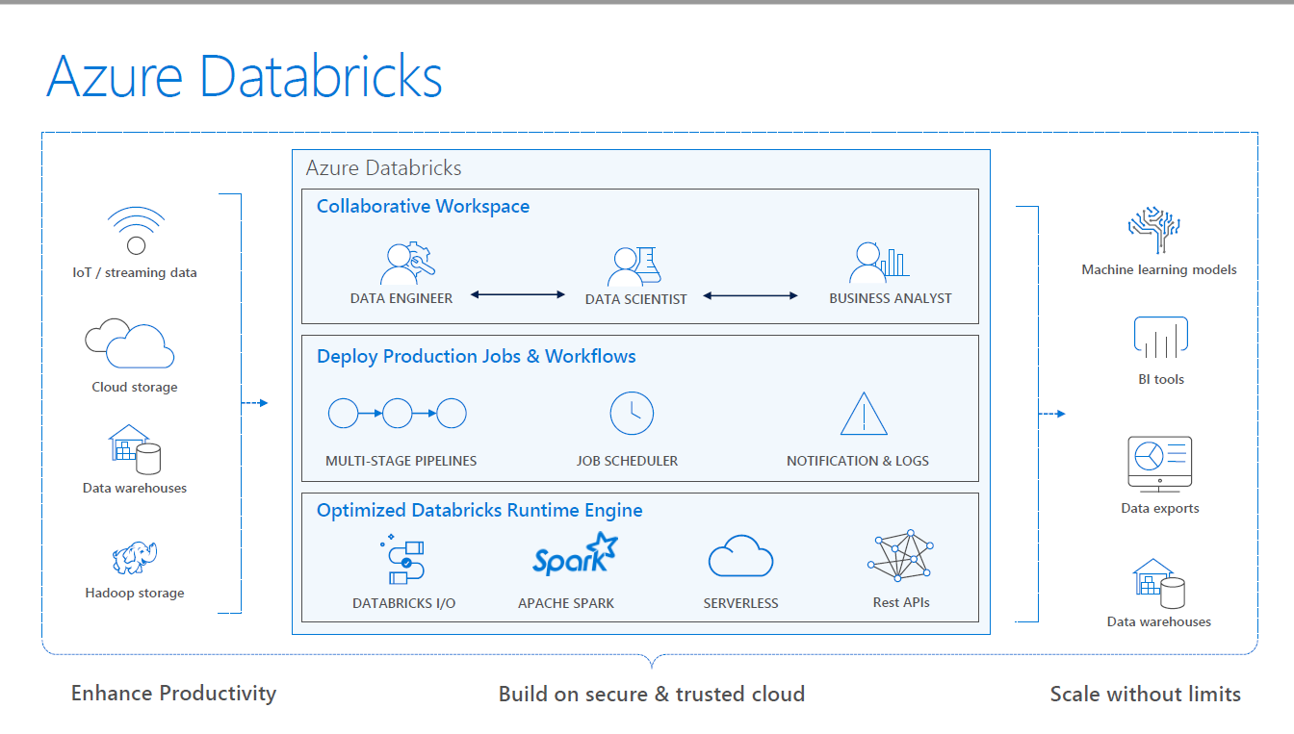

Slide 8
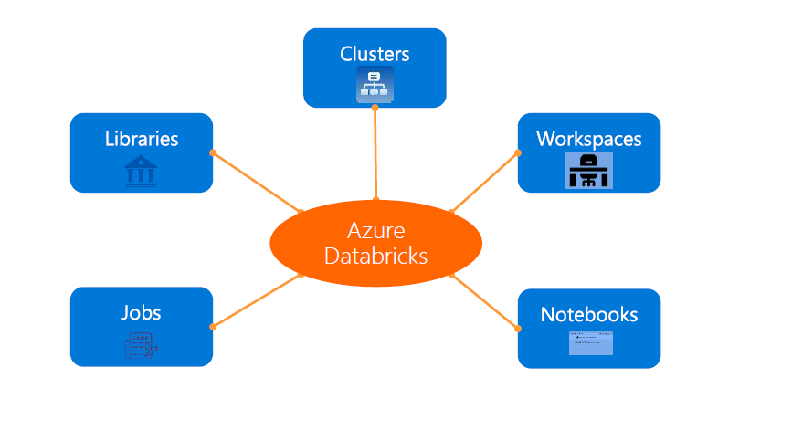
Azure Databricks Core Artifacts

Slide 9
Integration with AAD
There is no need to define users—and their access control—separately in Databricks.
AAD users can be used directly in Azure Databricks for all user-based access control (Clusters, Jobs, Notebooks etc.).
Databricks has delegated user authentication to AAD enabling single-sign on (SSO) and unified authentication.
Notebooks, and their outputs, are stored in the Databricks account. However, AADbased access-control ensures that only authorized users can access them.

Slide 10
Clusters : Auto-scaling and Auto-termination
Simplifies cluster management and reduces costs by eliminating wastage
When creating Azure Databricks clusters you can choose Autoscaling and Auto Termination options.
Autoscaling: Just specify the min and max number of clusters. Azure Databricks automatically scales up or down based on load.
Auto Termination: After the specified minutes of inactivity the cluster is automatically terminated.

Slide 11
Jobs
Jobs are the mechanism to submit Spark application code for execution on the Databricks clusters
Spark application code is submitted as a ‘Job’ for execution on Azure Databricks clusters
Jobs execute either ‘Notebooks’ or ‘Jars’
Azure Databricks provide a comprehensive set of graphical tools to create, manage and monitor Jobs.

Slide 12
Workspaces
Workspaces enables users to organize—and share—their Notebooks, Libraries and Dashboards
Everything in a workspace is ordered into hierarchical folders
Fine grained access controls can be defined in workspaces to enable secure collaboration among collegues

Slide 13
Notebooks
Notebooks are not only for authoring Spark applications but can be run/executed directly on clusters
Shift+Enter
Notebooks support fine grained permissions—so they can be securely shared with colleagues for collaboration (see following slide for details on permissions and abilities)
Notebooks are well-suited for prototyping, rapid development, exploration, discovery and iterative development

Slide 14
Visualization
All notebooks, regardless of their language, support Databricks visualizations.
When you run the notebook the visualizations are rendered inside the notebook in-place
The visualizations are written in HTML.
You can save the HTML of the entire notebook by exporting to HTML.
If you use Matplotlib, the plots are rendered as images so you can just right click and download the image
You can change the plot type just by picking from the selection

Slide 15
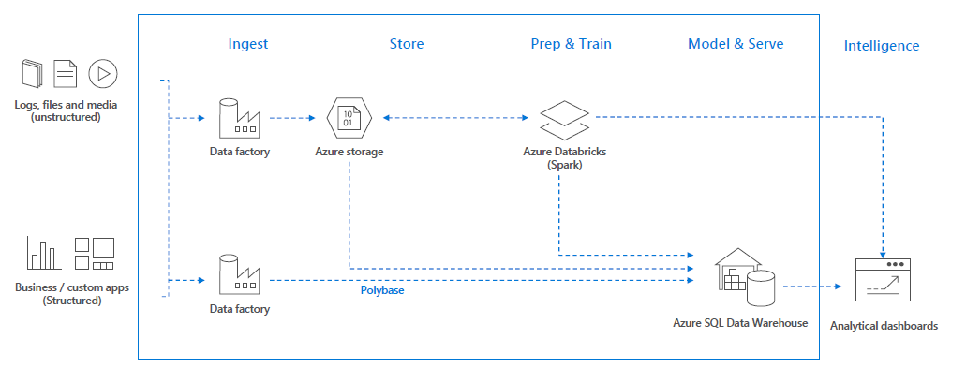
Use cases – Modern Big Data Warehouse

Slide 16
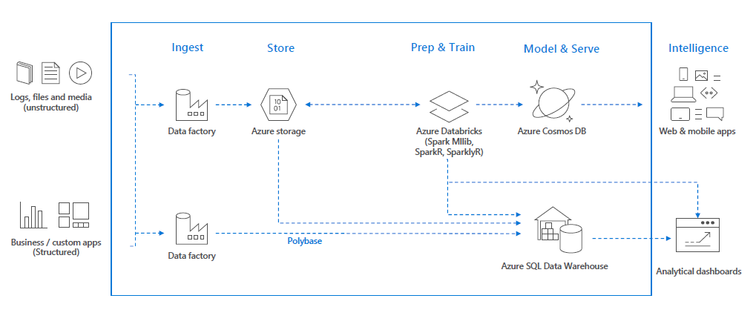
Use cases – Advanced Analytics on Big Data

Slide 17
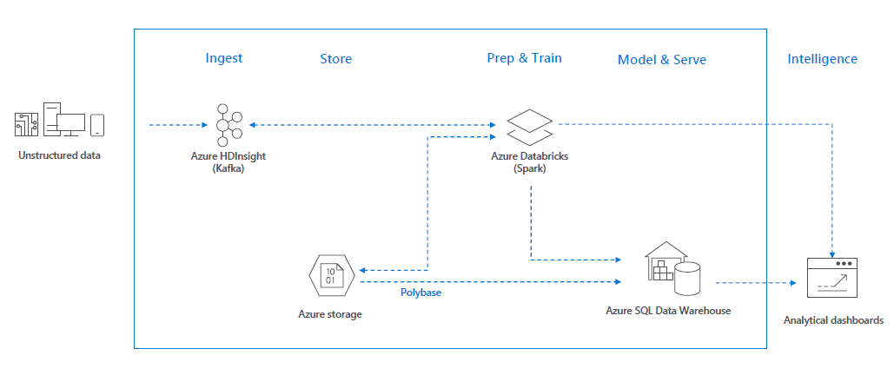
Use cases – Real-time analytics on Big Data

Slide 18
Demo

